Slide 1

Time Prediction Model for Automotive Production Line
Presented by Group 16

Slide 2




Meet the Team
Tarin Nurany Junior in Computer Science
Ananta Poudel Senior in Computer Science
Jiadong Gui Senior in Computer Science
Md Abiruzzaman Palok Junior in Computer Science

Slide 3


Overview
Introduction
Architecture
Gathering and refining data
Creating and assessing models
Constraints, potential enhancements
Real-world implementation
Demonstration

Slide 4


Project Idea
Collaboration with Freedom Motors USA (Wheelchair Accessible Car building Company)
Employees work at different stations to build different parts for a specific car
Station: Engine
Station: Wheel
Station: Bumper
Our Goal: Predict employee working time

Slide 5
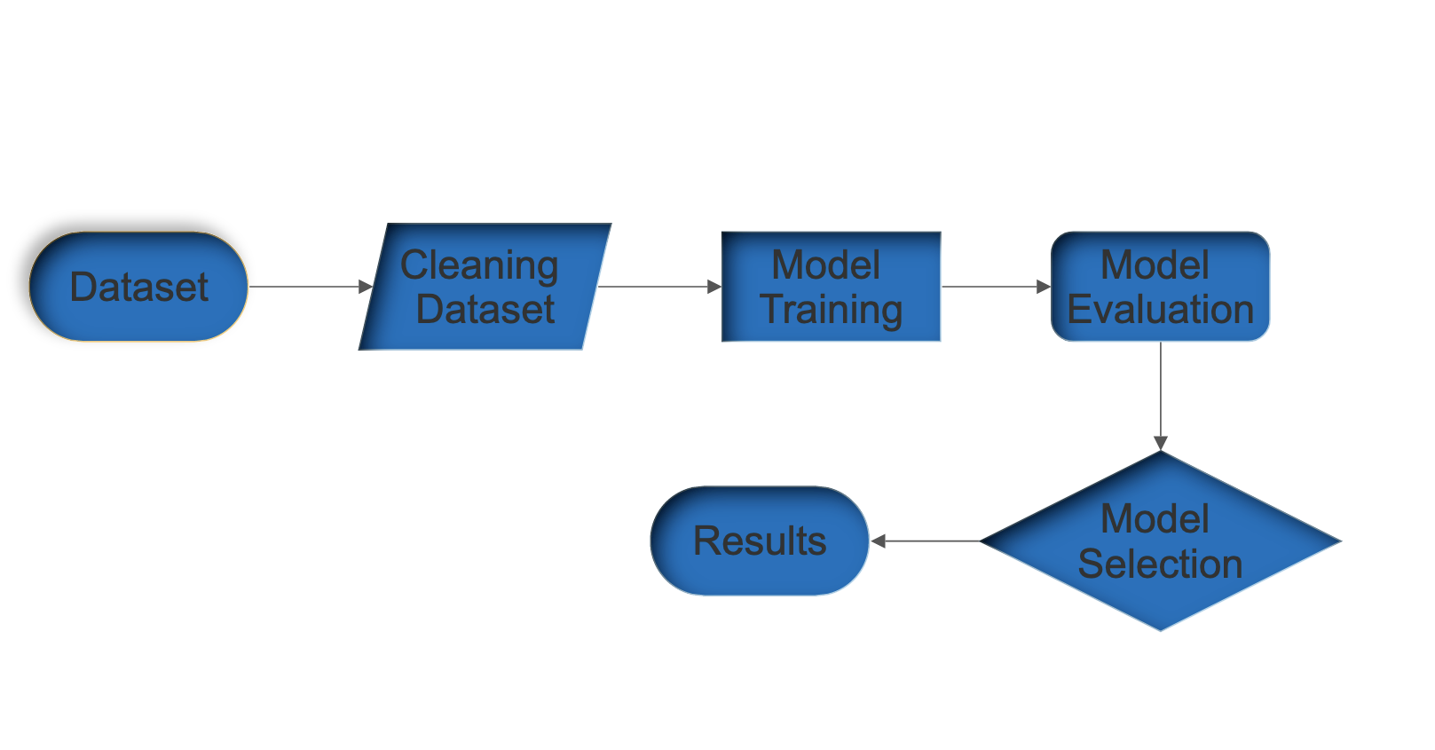
Architecture

Slide 6
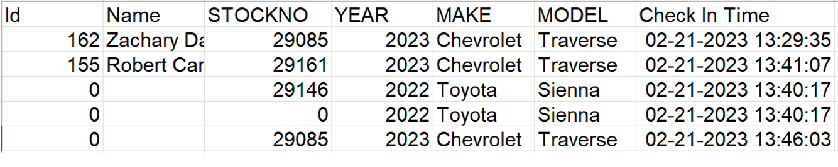
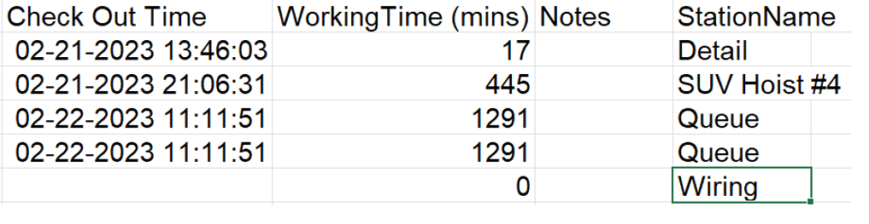
Data Collection and Clean up
We received a dataset from Freedom Motors USA of 789 Cars (26,414 records)
Columns removed
Employee Name
Stock Number
Check-in Time
Check-out Time
Notes
Rows Removed
Empty cells
Cells with working time 0
Stations – Queue, Detail, and etc

Slide 7
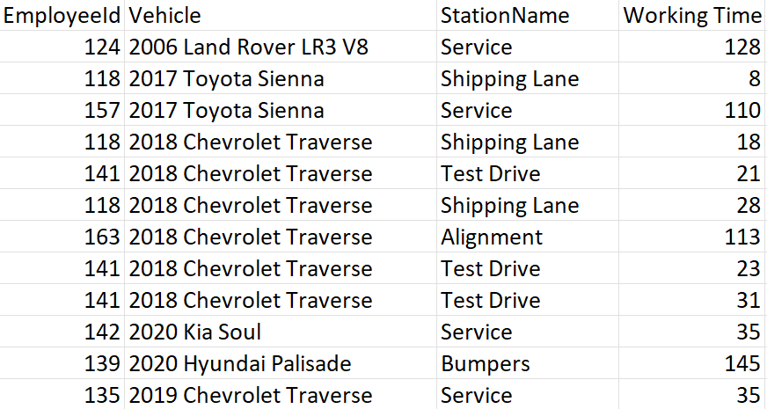
Final Dataset
After cleaning up
Merged year, make, and model to Vehicle
Added lunchtime
Removed Outliers
Total number of records 5136
Implementations of data
Station Name - One Hot encoding
Vehicle – Label Encoding
L

Slide 8
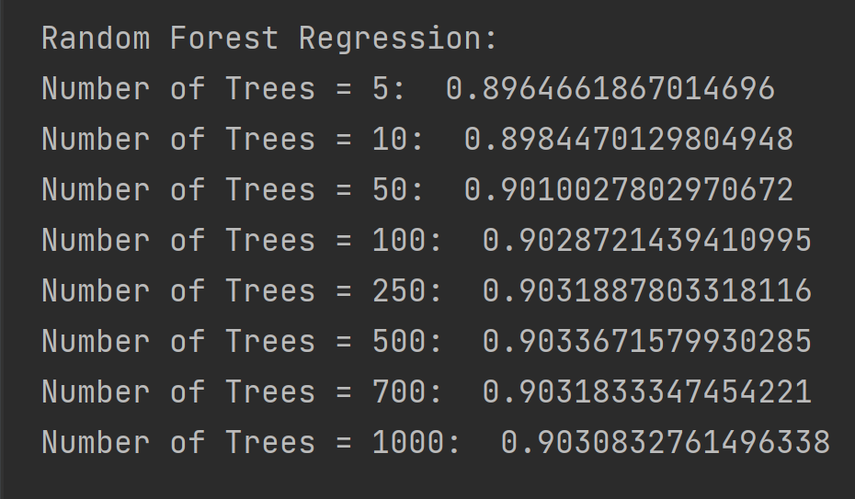
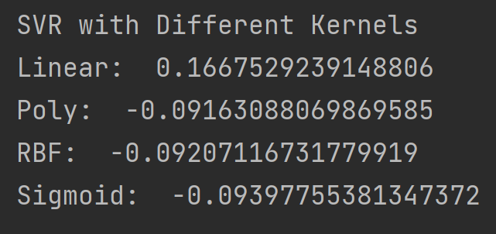
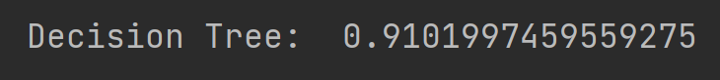
Model Training and Evaluation
R^2 Scores on Test Set yielded by different models:

Slide 9
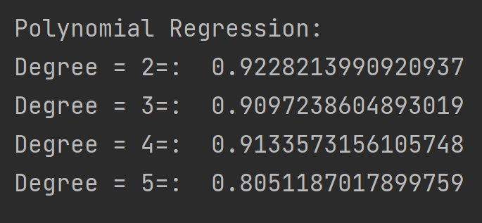
Model Training
R^2 Scores on Test Set yielded by different models:

Slide 10
Let’s see a demo

Slide 11
Limitations
Predict the time for employees that the model never saw before.
Predict the time for Vehicles that the model never saw in the training.
Predict time based on different Vehicle conditions.
More than one person working on the same task yields poor predictions.

Slide 12
Future Improvements
Improve data and model to be able to predict time for individual employees.
Include data on extra features and options to make better predictions (i.e., the Detail station mentioned previously).
Include employee data (i.e., age, experience, skills, etc.) to make more accurate predictions for individual employees.

Slide 13



Real World Application
Any Industry Production line.
Accurate Completion Time for stores like car repair shops.
Improve any store's overall employee efficiency.

Slide 14
Any Question?

Slide 15
Thank you

